Slide 1
Optical Box for Optical Computing
Optical Box operated under control of embedded computer for Optical Computing like Fourier Transform by a Lens or 2D Fourier Transform. Calculation price (or energy power per single math operation) of Optical Box is 5-10% or less of Discrete Processor calculation price. Optical Computing is not a universal panacea of Computing Industry. It has many limitations, need special knowledge, and need additional research in math, optics and algorithms.

Slide 2
History
Optical Computing is not a modern idea or technology. Optical Computing idea was popular in 1980-1990. There are many publications and research exists, but until now, no one device sold for public.
Major technics used for Optical Computing is Fourier Transform by a Lens or 2D Fourier Transform.
During previous century electronic components was expensive, other components was unique and do not provide required quality to make product for everyone. Therefore, computing technology has been concentrated to manufactory Discrete Processors based on logic of switchers and transistors.

Slide 3
Consumer chip market analysis results
My own research and analysis of price and characteristics of electronic components presented on consumer chip market (beginning of 2015), show that Optical Box for Optical Computing operated under control of embedded computer can be manufactured with follow properties:
Dimension of single Optical Box for Optical Computing do not exceed the dimension of modern Discrete Processor with cooling radiators.
Computing effectivity of Optical Box for Optical Computing (for special calculations) are compatible to computing effectivity of modern Discrete Processor of same size (with cooling radiators).
Manufacturing price of Optical Box for Optical Computing is chipper than manufacturing price of modern Discrete Processor and do not required so expensive equipment and buildings.
Calculation price (or energy power per single math operation) of Optical Box is 5-10% or less of Discrete Processor calculation price.
Therefore, Optical Box do not required additional cooling system like modern Discrete Processor.

Slide 4
Comparisons matrix of stock prices and energy power required
Processor Type | Xeon E5
Chips for Full HD 1920 * 1080 50Hz |  | 1 | 8
Productivity | ~200GFlops | ~1GFlops | ~512GFlops
Stock price | ~1000USD | ~150USD | ~3000USD
Energy power | ~135W | ~0.1W | ~1W
Stock price/ Productivity | ~5USD/ GFlops | ~150USD/ GFlops | ~6USD/ GFlops
Energy power / Productivity | ~0.75W/ GFlops | ~0.1W/ GFlops | ~0.2W/ GFlops

Slide 5
Trends Analysis
Analysis of trends show me that single Optical Box for Optical Computing with a size like the size of modern Discrete Processor with cooling radiators will have the bigger computing effectivity and smaller calculation price (or energy power per single math operation) then the same size Discrete Processor with cooling radiators.

Slide 6
Why Optical Computing?
Optical Computing is not a universal panacea of Computing Industry. It has many limitations, need special knowledge, and need additional research in math, optics and algorithms.
With using Optical Computing a lot of money and energy spend to simple math calculation will be saved.

Slide 7
Economics
Average computer mainframe electric bill can be 100K$/month and up.
Number of mainframes worldwide are hundreds.
Big part of money are spend to energy power for typical calculations that can be done with Optical Computing with price 90-95% or more less as usually.
Take part of money saved is a main aim for this project.
For example,
Let 100 mainframes have average electric bill can be 100K$/month
Let using Optical Computing will cut electric bill to 50%.
If 10% of saved money will be spend to Optical Computing maintenance
Then 100*100K$/month*50%*10% = 500K$/month can be spend as subscription plan for Optical Computing maintenance.
Hardware sales, third-party software licensing and consulting will generate additional money income for project.

Slide 8
Planned Cash Income Sources
Subscription Plans
Hardware Sales
Third-Party Software Licensing
Consulting

Slide 9
Applied Fields of Optical Computing
Video and Audio Processing.
Patterns Recognitions.
Trends Analysis.
Network Data Transmission.
Cryptography.
Scientific Calculations.
And more, more and more

Slide 10
Who will use Optical Computing?
Banks and Brokerages to predict stock trends.
Medical Laboratory to analyze microscope images.
3D and 2D Designers to render images of scene.
Sound Recorders to remove noise or detect voice.
Robot Designers for computer vision or AI.
And more, more and more

Slide 11
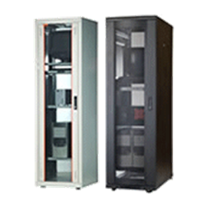
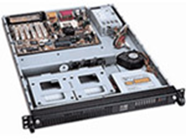
Hard & Soft
I intend to manufactory Optical Box for Optical Computing as 19’’ rack-mount case with an embedded control system and network interfaces. This manufacturing schema allow using Optical Box for Optical Computing as a Personal Device or as a Mainframe Part.
The Optical Box for Optical Computing will operate with other application and tools using web-based API (Application Program Interface) like REST, SOAP or similar. Plugins and Add-ons will be developed for the most popular applications like Adobe Photoshop, Solidworks, 3D Max, Ninjatrader, etc.

Slide 12
Roadmap
A roadmap for project required 1 year to start and include
R&D,
Market Analysis,
Negotiations,
Agreements,
Patents and Legal.

Slide 13
R&D main steps
R&D include Optical Box design and Optical Box Emulator development.
Optical Box Emulator will allow test and demonstrate functionality to customers and investors without full Optical Box manufacturing process.
Optical Box design required Component Supplier Analysis to be first.

Slide 14
Fourier Transform Usage Samples
To show how Optical Computing with 2D Fourier Transform can be used I develop some examples of image processing tools with 2D Discrete Fast Fourier Transform which is closed analogy of 2D Infinity Fourier Transform by Lens
Image Resize,
Image Blur,
Piece of Image Position Detection.
Software Packages and Tools was used for samples development
Microsoft Visual Studio 2013 C#
EmguCV/OpenCV – C++ computer vision library (bitmap data management part)
FFTWSharp/FFTW – C++ Discrete Fast Fourier Transform implementation

Slide 15
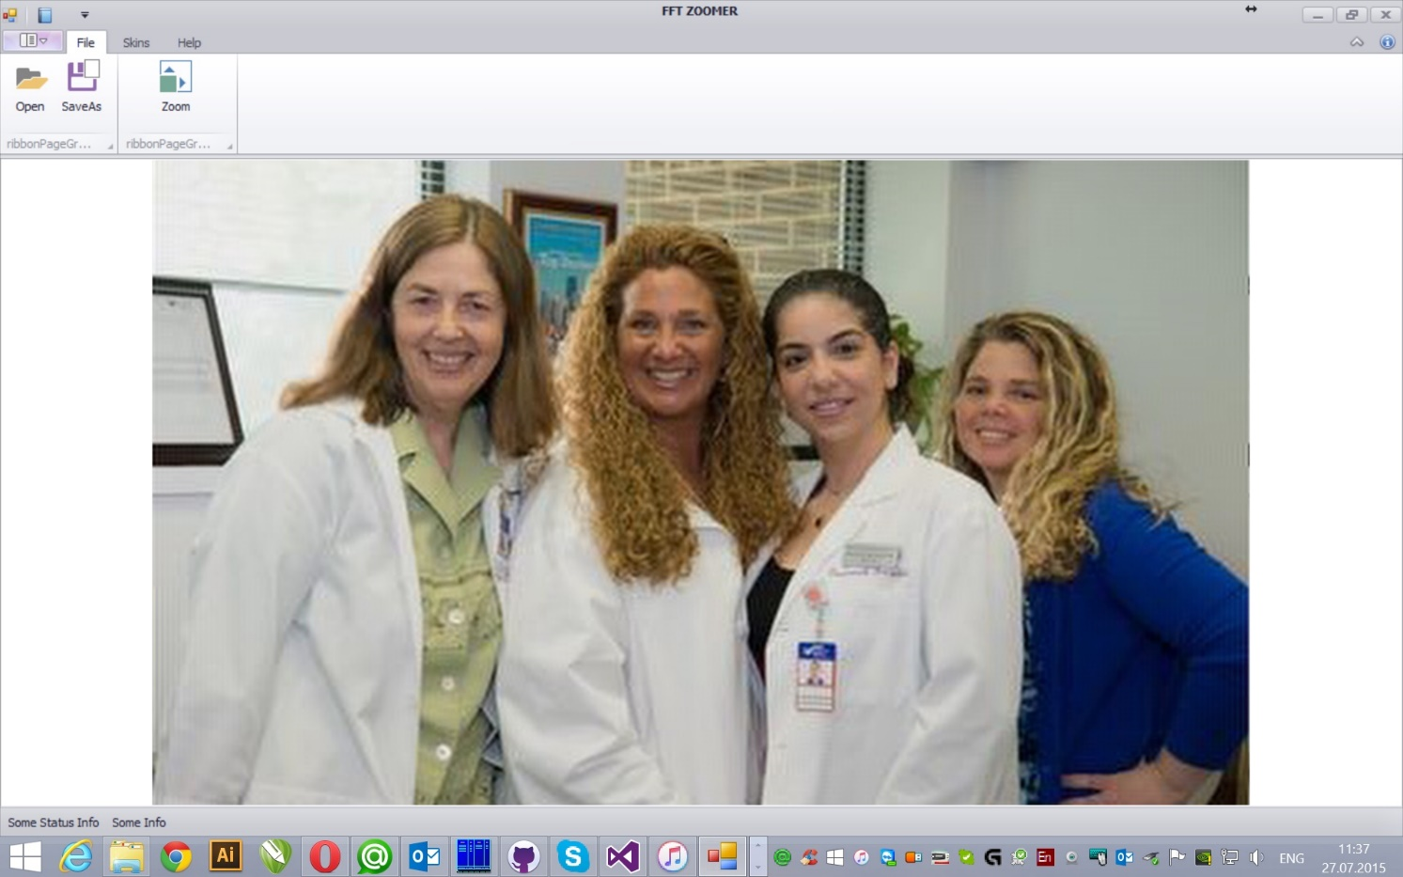
Image Resize Fourier Transform Usage Sample

Slide 16
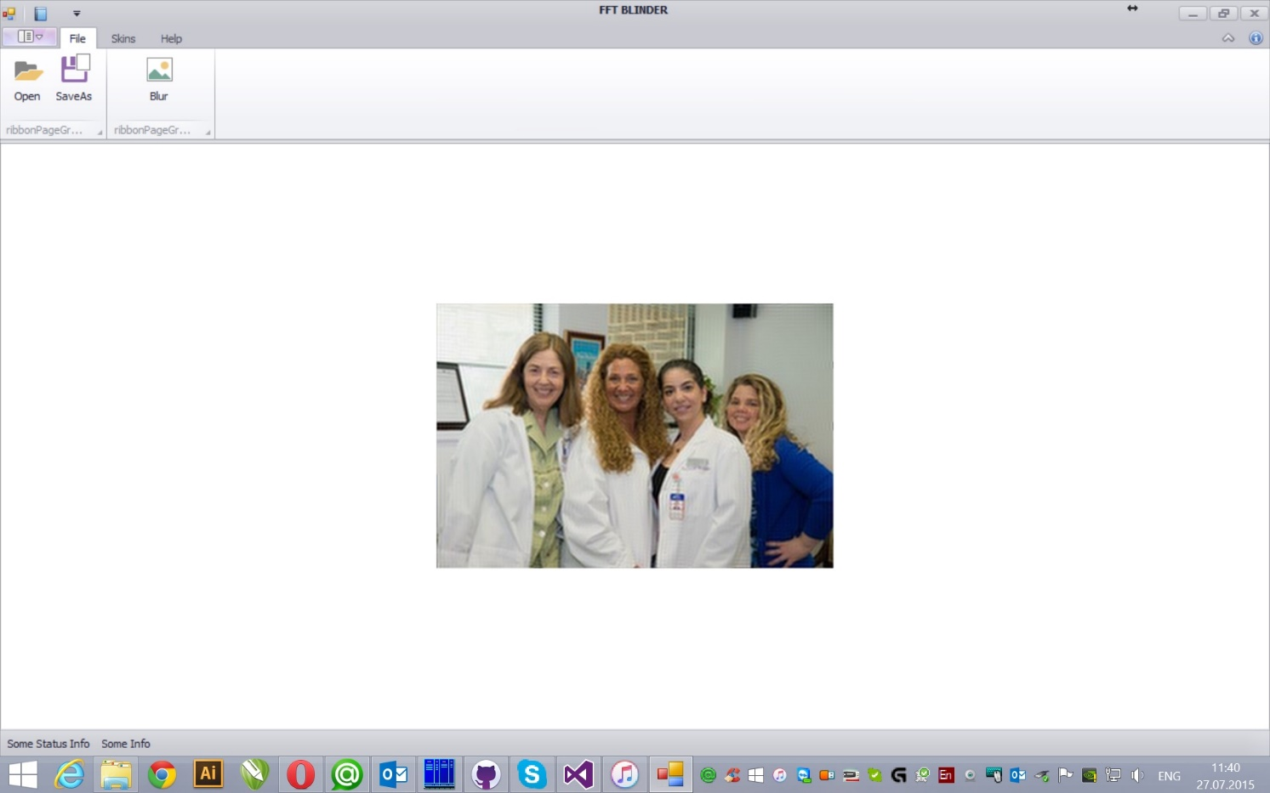
Image Blur Fourier Transform Usage Sample

Slide 17
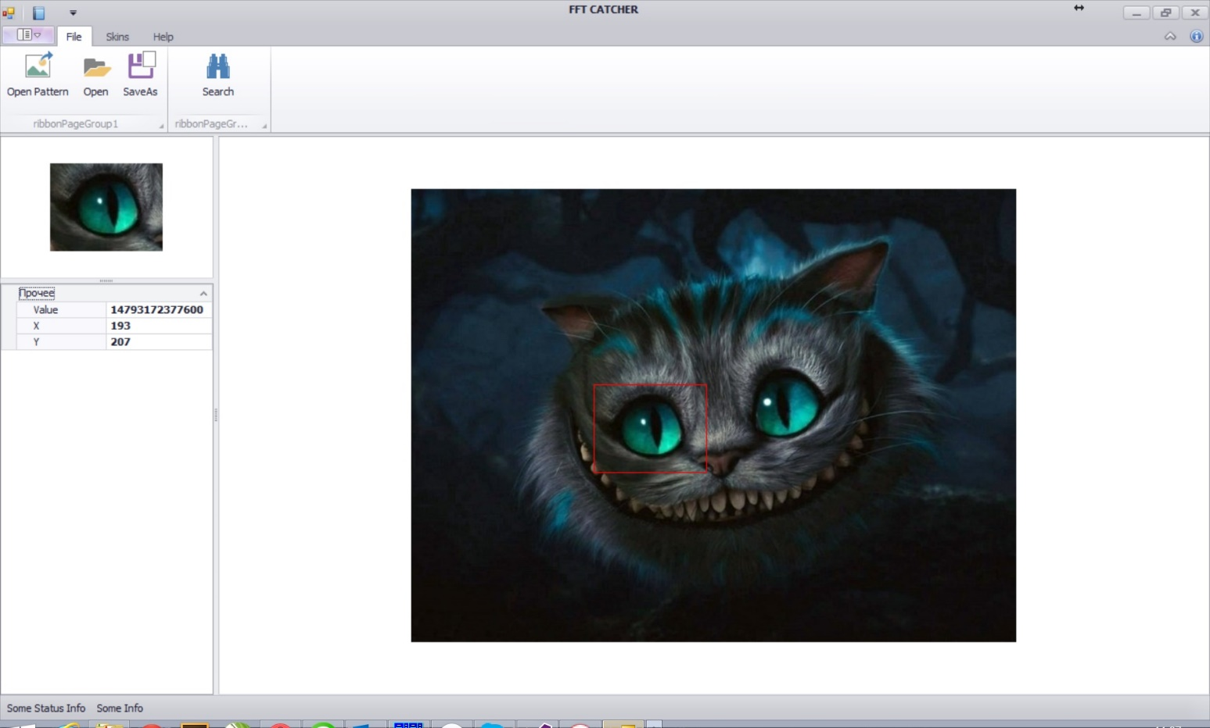
Piece of Image Position Detection Fourier Transform Usage Sample

Slide 18
Thank You
Contacts
Dmitry Protopopov, Moscow, Russia dmitry@protopopov.ru +7 916 6969591
Taras Kovtun, Boca Raton, FL, USA boss@rbadesign.us

